Slide 1
Design Patterns

Slide 2
What is design pattern?
General useable solution common reoccuring problems
Blue print to solve a problem
Predefine testable implemented solution
Obtain by trail and run

Slide 3
Who created design patterns?
In 1994, A book was published
Erich Gamma
Richard Helm
Ralph Johnson
John Vlisside
These all collectively known as GoF (Gang of four).

Slide 4
Questions

Slide 5
Do I really need to use design patterns?

Slide 6
Answer
No, It is not necessary and compulsory to use design pattern in your code.
BUT....

Slide 7
What are the benifits If I use design patterns in my code.

Slide 8
Benefits of using design patterns
Using testable/Proven solutions
Code readability
Maintaibility
Easy extension
Following Industry Standards
Speed up the development
Career motivation
Clear code

Slide 9
Categories of Design Patterns
As per the GoF there are 23 design patterns that fall under the three category
Creational
Structural
Behavioral

Slide 10
Creational
- Create objects for you, rather than having you instantiate objects directly. This gives your program more flexibility in deciding which objects need to be created for a given case.
In short - Object creation mechanisms

Slide 11
Structural
These concern class and object composition. They use inheritance to compose, interfaces and define ways to compose objects to obtain new functionality.
In Short - Class and object composition (Relationship between entities)

Slide 12
Behavioral
Most of these design patterns are specifically concerned with communication between objects.
In short - How objects communicate?

Slide 13
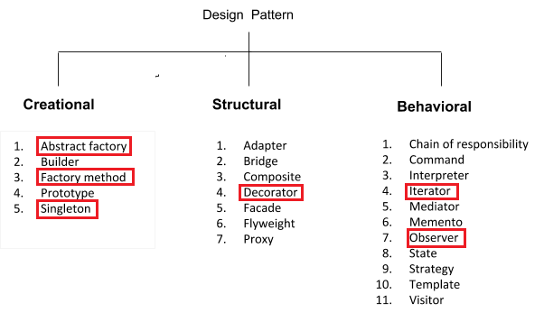
Design Patterns

Slide 14
Real Life Examples
First,
In a house there should be only one main power switch. May may face problem, If we have multiple switches, When electricity fault will happen and switch goes down, we may need to look every switch to make it on.
This problem fall under creational pattern, and problem is based on singleton pattern, because singleton pattern says that there should only and only instance of a class.

Slide 15
Real Life Examples
Second,
Suppose, If we are creating a cricket app (publisher), that notifies viewer (subscriber) when ever something change like current score, wicket fall, run rate changes etc, these data changes app will notify the subscriber.
This problem fall under behavioral pattern and probelm is based on observer pattern, because there is a publisher and subscriber.

Slide 16
Creational
Factory Pattern
Define an interface for creating an object, but let sub classes decide which class to instantiate. This lets a class defer instantiation to subclass.
Straight Talk
Allows programmers to request objects and have the correct type created behind the scene and returned.

Slide 17
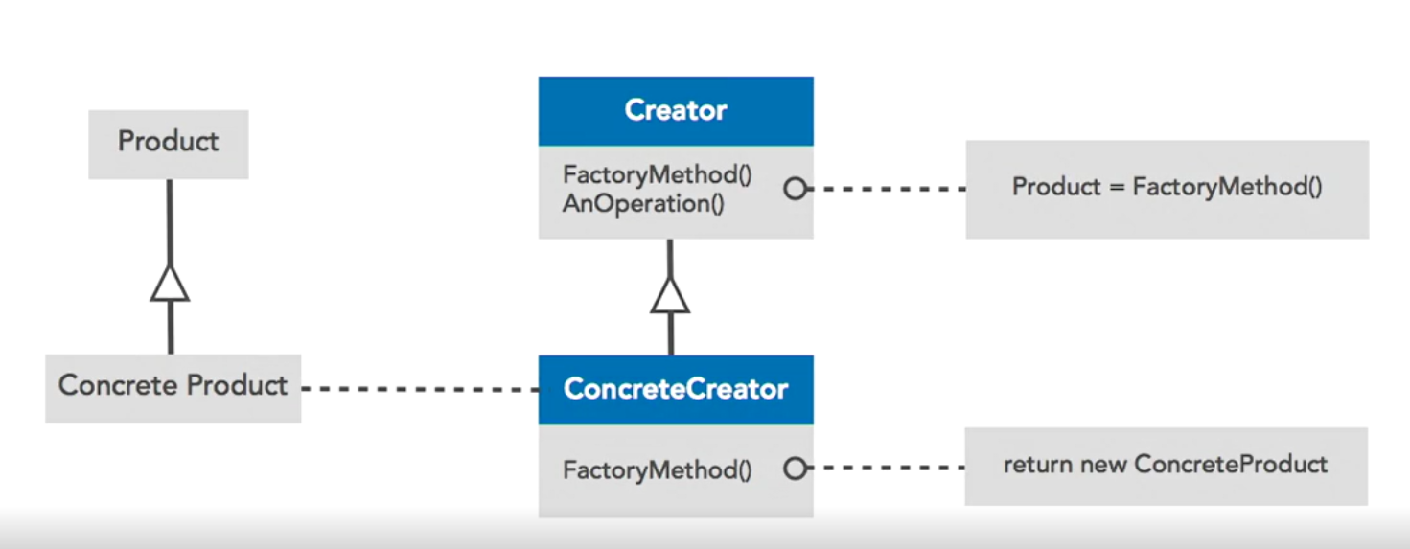

Slide 18
Creational
Abstract Factory
Provide an interface for creating families of related or dependent objects without specifying their concrete classes.
Straight Talk
Ultimately a factory for other factories.

Slide 19
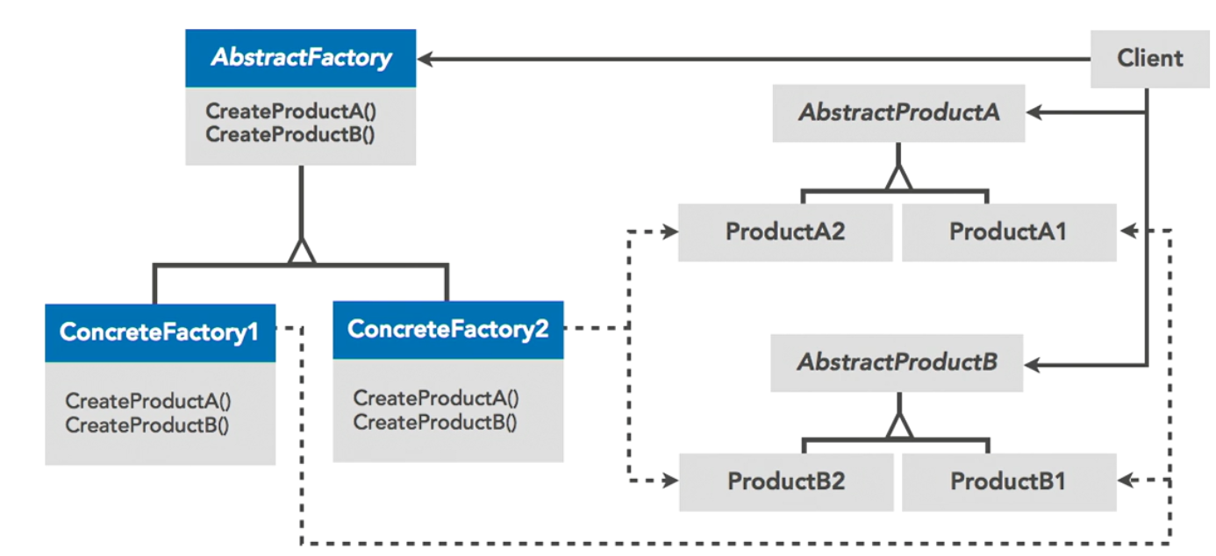

Slide 20
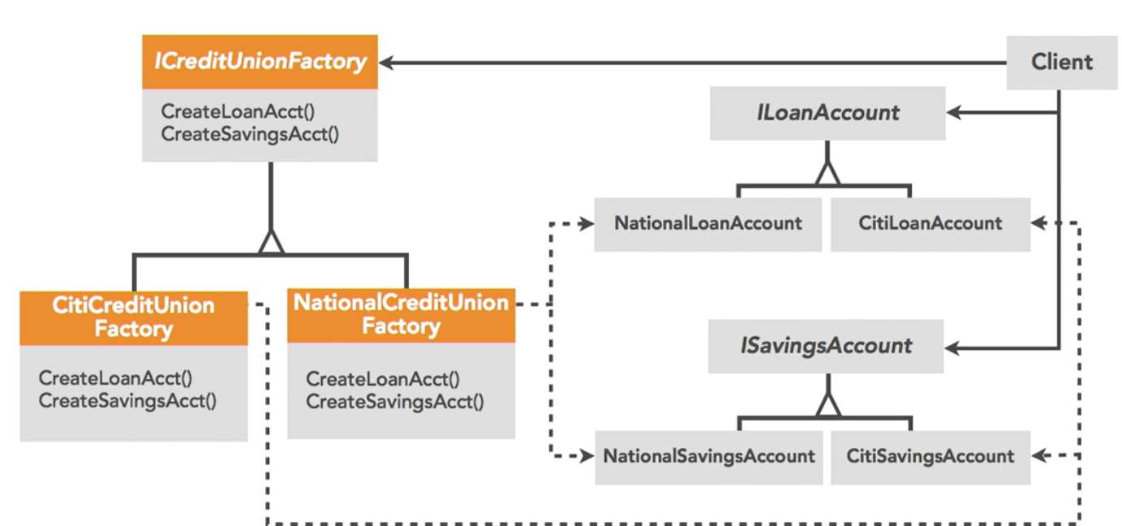

Slide 21
Creational
Singleton
Ensure a class has only one instance and provide a global point of access to it.
Straight Talk
Eliminate the option of instantiating more than one of the same object.

Slide 22
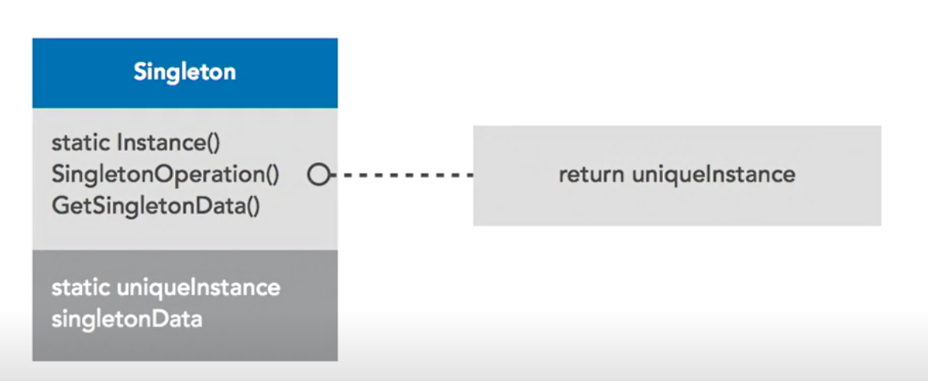

Slide 23
Real life examples-
Logging
handling database connections
print spooling
etcs
Lazy Initialization
Performance effective.
On-demand object creation
Helps application to load faster because it does not depend upon instance creation at the time of application start up. .

Slide 24
Eager Initialization
Opposite of lazy initialization
Initializing the object, keeping it in memory for future
Static vs Singleton
1.singleton is an architectural concept. Static is a key word and language feature.
2. Singleton class can implements interface where you can pass the another implementation, with the static class you can not.
3. At some stage if we need to dispose the object of singleton object than we can but in the case of static we can not do until application ends.

Slide 25
Structural
Decorator
Attaches additional responsibilities to an object dynamically. Decorator provides a flexible alternative to subclassing for extending functionality.
Straight Talk
Using composition to limit inheritance and simplify object relationship to make them more manageable.

Slide 26
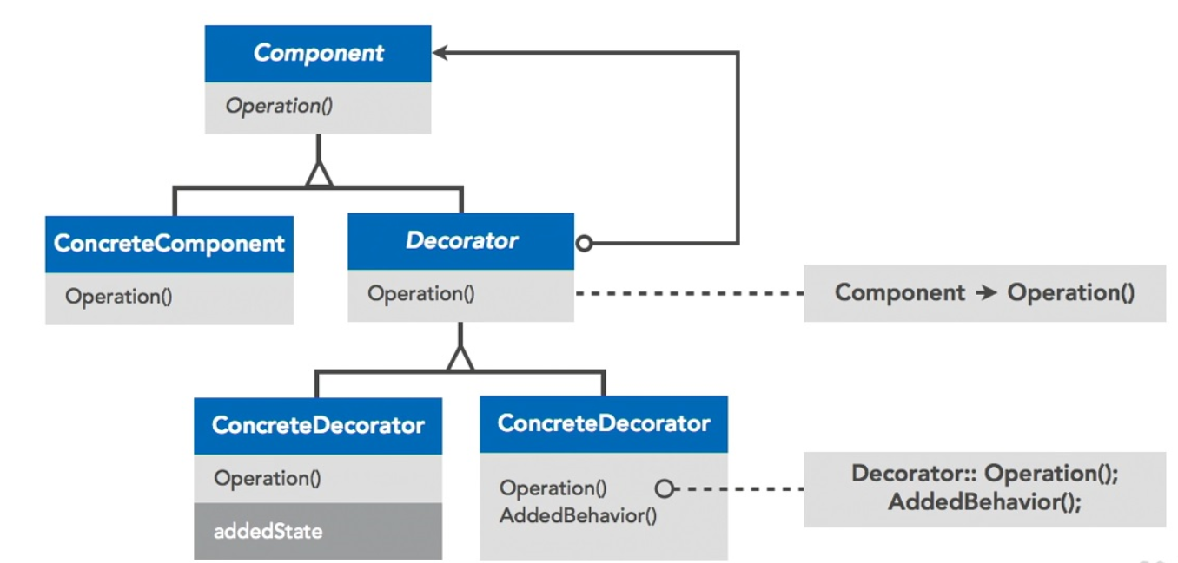

Slide 27
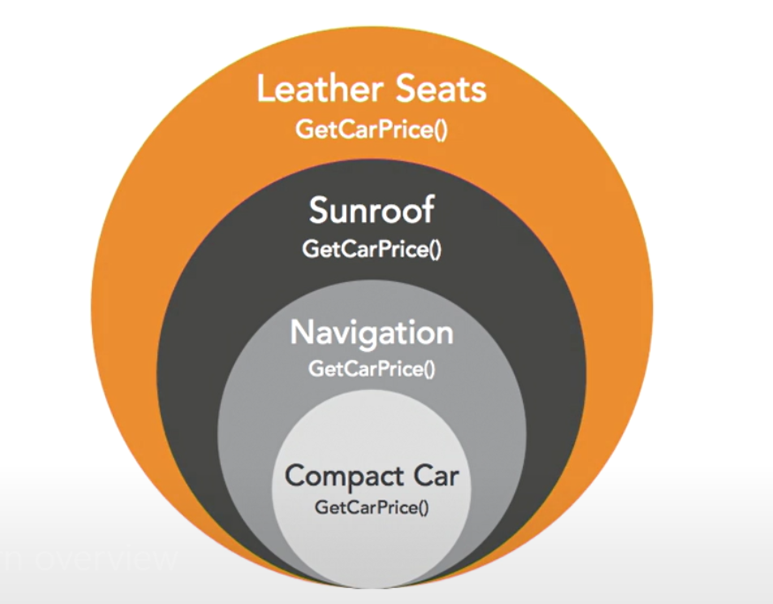

Slide 28
Behavioral
Observer
Defines a one-to-many dependency between objects so that when one object changes state, all its dependents are notified and updated automatically.
Straight Talk
Change in one object cause a change or action in another.

Slide 29
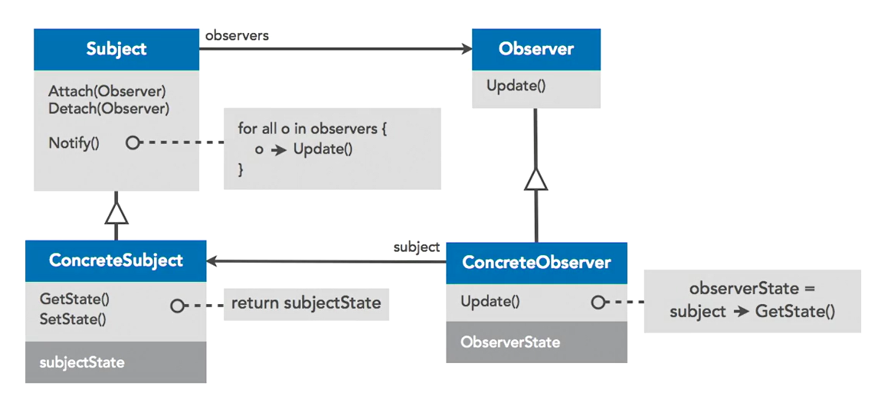

Slide 30
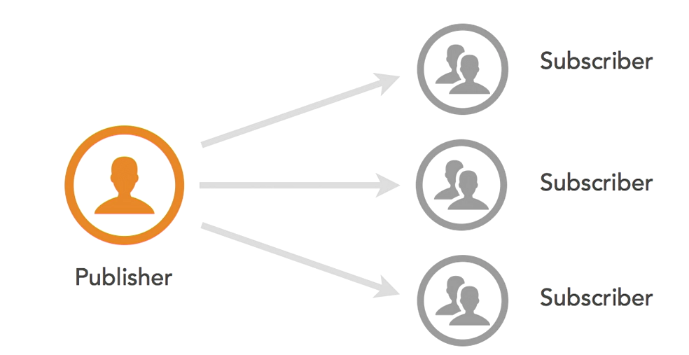

Slide 31
Examples
Event handling uses the observer pattern.
Mouse clicks trigger an event as the publishers.
Object execution an action as the subscriber.

Slide 32
Behavioral
Iterator
Provide a way to access the elements of an aggregate object sequentially without exposing its underlying representation.
Straight Talk
Provides a way to access and iterate through collections in the same way, regardless of type.

Slide 33
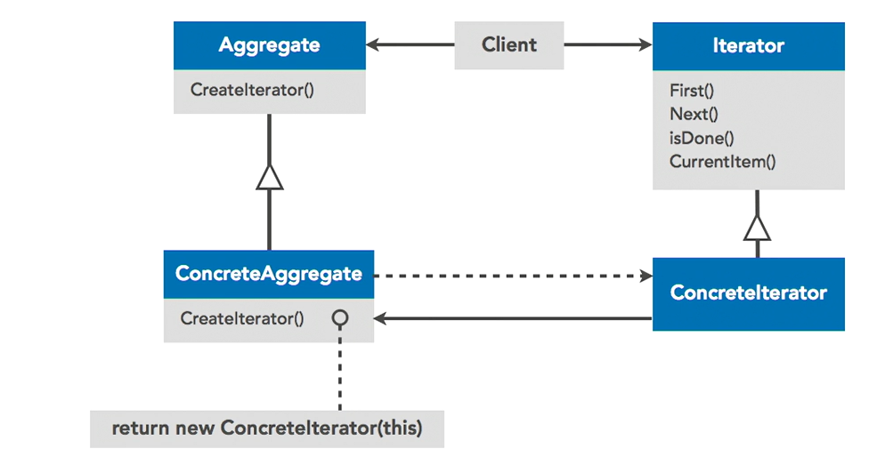

Slide 34
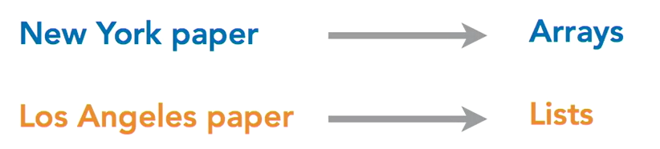

Slide 35
Thanks

